Slide 1
FINANCIAL SERVICES

Slide 2
Choosing a Financial Institution - Consider:
Location
Availability of ATM’s
Fees
Interest
Features
Direct deposit
Automatic payments
Online Banking
Discounts/Cash back features
Student features (discounts, savings, high interest)

Slide 3
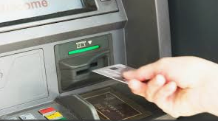
ELECTRONIC BANKING
ATM (Automated Teller Machine)
Deposit cash or cheques
Withdraw cash (including varying denominations)
Check your account balance

Slide 4
ONLINE BANKING
Computer or Smart Phone
Check your account balance
Transfer money between accounts
Pay credit card bill
Pay bills
Set up automatic bill payments
E-transfer funds

Slide 5
ELECTRONIC BANKING
Automatic Deposits (from employer)

Slide 6
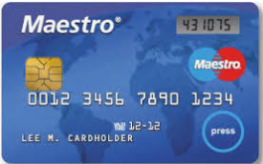
DEBIT CARD
Point of sale purchases and returns
Online Shopping

Slide 7
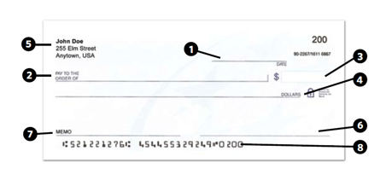
CHEQUES
Sports and Extracurricular Club Fees
Deposit for a large purchase – Car, home, etc. ( may need to be certified)
Bill Payments
Look at the cheque image. What does each number represent?

Slide 8
DISCUSSION
Why are financial institutions necessary?
What are the most important things you would consider when choosing a financial institution?

